Slide 1
Collaborative Buddhist Text Annotation
with Layered Document
Yap, Cheah Shen
yapcheahshen@gmail.com
ECAI Workshop, PNC 2016
August 18th, 2016
J. Paul Getty Museum, Los Angeles, California
Notes:
Thank you for having me here, I’m proposing a new way to resolve the syncronization problem of Buddhist Text annotation.

Slide 2
The Insularization caused by Copy/Paste
To create text annotation, we make a copy from an authoritative source, e.g CBETA, and paste it to the software (usually a text editor).
The copied text is in fact a new independent version, which cannot reflect changes in source text which are made after copy/paste.
As annotations are tied up with different version of base text. Annotations cannot be merged without human intervention.
Notes:
One of the first thing we learn in computer is copy & paste (Ctrl+C, Ctrl+V). which is very easy and works across every software.
fix 祗to 祇in source document,
add Jetavana in target 2 and explain 3)

Slide 3
Multiple Insularized File
如是我聞一時佛在舍衛國祗樹給孤獨園
如是我聞一時佛在舍衛國祗樹給孤獨園
如是我聞.Insula一一時，佛在舍衛國祗樹給孤獨園
如是我聞,一時,佛在舍衛國祗樹給孤獨園..........
Notes:
Annotation is added directly to the base text, since the base text is also editable, causing the files to evolved independently.

Slide 4
Single Version Approach
Do not make copy, everyone should work on same XML/TEI file.
To make sure everyone working on same text have identical clones:
Single-write-multiple-read policy.
Distributed Revision Control System (Github)
Even we can enforce everyone to work on same XML/TEI file. It will become a big mess soon enough. Imagine 50 students writing note on same text book.
Notes:
1)Do not touch the file while I am still making changes.
2)To get used to git, you will need lot of knowledge and practice, or your need to have an IT expert in your team.

Slide 5
Single Version Approach
如是我聞一時佛在舍衛國祗樹給孤獨園
“Too many cooks spoil the broth, Too many tags spoil the file.”
Notes:
*Compare with Multiple Insularized File.

Slide 6
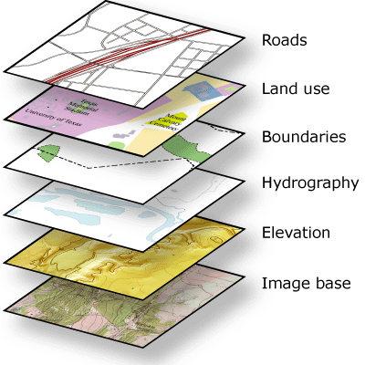
Solution: Layered Document
Annotate on a separate layer.
layer works like a transparent film on top of base text, which can be added, removed and combined easily.
Annotator has full control to his own layer, but cannot change the base text and layers created by other annotators without permission.
Notes:
Layered Document to the rescue.

Slide 7
Layered Document
如是我聞一時佛在舍衛國祗樹給孤獨園
如是我聞一時佛在舍衛國祗樹給孤獨園
如是我聞一時佛在舍衛國祗樹給孤獨園
如是我聞一時佛在舍衛國祗樹給孤獨園
如是我聞一時佛在舍衛國祗樹給孤獨園
Notes:
Each user work on their own layer, and the Administrator might have a combined layer.

Slide 8
Text pointer in
Layered Document
Copy&paste vs
Internally
Source Document
Target Document
Source Document
xxxxx
xxxxx
[0,4,”da8”]
xxxxxx
xxxxx
xxxx
如是我聞
如是我聞
xxxx
xxxxx
如是我聞xxxx
xxxxx
Visually
Ctrl+C
Ctrl+V
xxxxx
xxxxx
如是我聞
xxxxxx
xxxxx
xxxx
System Clipboard
Notes:
when Ctrl+C is pressed, the content of source document is copied to system clipboard, and when Ctrl+V is pressed, the content of system clipboard is pasted on target document. the source and target document doesn’t know each other.
With text pointer, a reference network is created naturally, which means source document knows which target document is pointing to it.

Slide 9
A Prototype of Layered Document system
Web based layered text editor
100% Javascript
Highly customizable
Optional tree structure (for Kepan)
  XML has to be an valid tree structure in memory (as required by Document-Object-Model)
  Tree structure prevents simple slicing and merging of XML files.
Notes:
To proof the above mentioned concept, I have create a prototype of layered document system.
4) practically I think a compulsory tree structure has more restriction than benefit, because when we break an XML into smaller files, it is no longer valid, and when we trying to combine multiple XML into a single file, it is not valid either, until you add or remove some tags, this is not an easy work especially your XML files are deeply nested.

Slide 10
LIVE DEMO

Slide 11
Thank you for your attention
This Prototype of Ksana Layered Editor is sponsored by
Bodhiyana Foundation http://www.bodhiyana.org
URL of this slide
https://goo.gl/E0jalv

